Slide 1
Lecture 02
Microprocessor and Computer Evolution

Slide 2
ENIAC - background
Electronic Numerical Integrator And Computer
Designed by Eckert and Mauchly
University of Pennsylvania
Mainly used for Trajectory tables for weapons
Started 1943
Finished 1946
  Too late for war effort
Used until 1955

Slide 3
ENIAC - details
Decimal Number Based System (not binary)
20 accumulators of 10 digits
Programmed manually by switches
18,000 vacuum tubes
30 tons
15,000 square feet
140 kW power consumption
5,000 additions per second

Slide 4
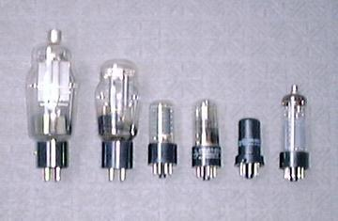
Vacuum tubes

Slide 5
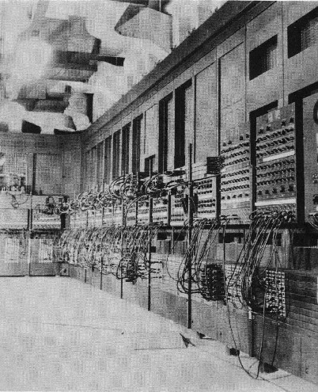
ENIAC

Slide 6
von Neumann/Turing
Stored Program concept
Main memory storing programs and data
ALU operating on binary data
Control unit interpreting instructions from memory and executing
Input and output equipment operated by control unit
Princeton Institute for Advanced Studies
  IAS
Completed 1952

Slide 7
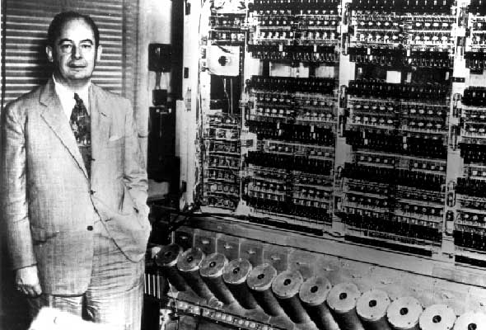
von Neumann
Von Neumann with the first Institute computer

Slide 8
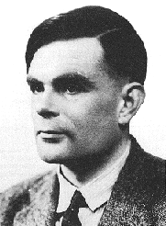
Alan Turing

Slide 9

Structure of von Neumann machine

Slide 10
IAS - details
1000 x 40 bit words
  Binary number
  2 x 20 bit instructions
Set of registers (storage in CPU)
  Memory Buffer Register: Contains a word to be stored in memory or is used to receive a word from memory.
  Memory Address Register: holds the address of a word that moves to/from MBR.
  Instruction Register: Contains the 8-bit opcode instruction being executed.
  Instruction Buffer Register: Holds temporarily the right hand instruction from a word in memory.
  Program Counter: Contains address of the next instruction pair to be fetched from memory.
  Accumulator: Holds one of the operands and results of ALU operations.
  Multiplier Quotient: Hold the least significant 40 bits of multiplying result

Slide 11

Structure of IAS – detail

Slide 12
Commercial Computers
1947 - Eckert-Mauchly Computer Corporation
UNIVAC I (Universal Automatic Computer)
US Bureau of Census 1950 calculations
Became part of Sperry-Rand Corporation
Late 1950s - UNIVAC II
  Faster
  More memory

Slide 13
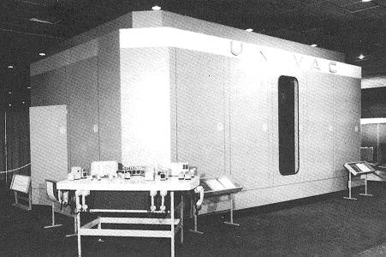
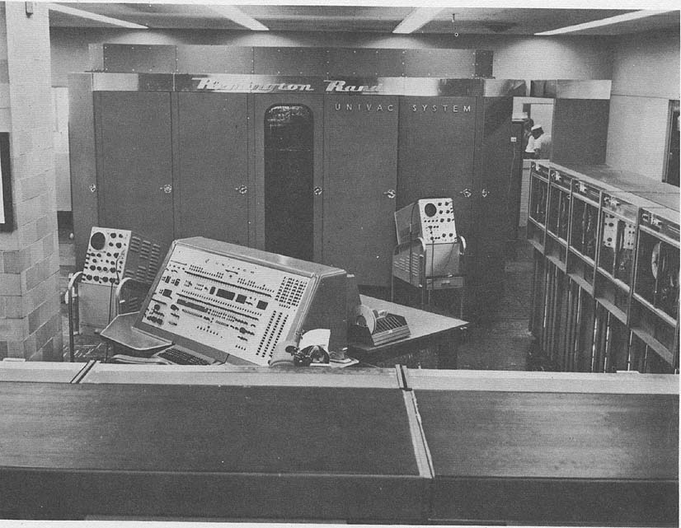
UNIVAC I
UNIVAC II

Slide 14
IBM
Punched-card processing equipment
1953 - the 701
  IBM’s first stored program computer
  Scientific calculations
1955 - the 702
  Business applications
Lead to 700/7000 series that established IBM as the dominant computer manufacturer.

Slide 15
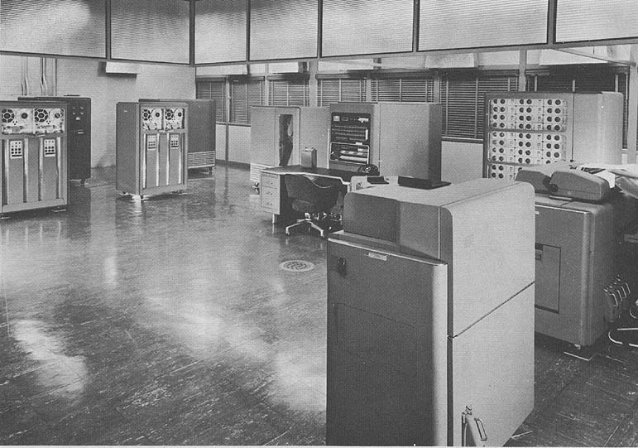
IBM 701

Slide 16
Transistors
Replaced vacuum tubes
Smaller Size
Cheaper than earlier vacuum tube
Less heat dissipation
Solid State device
Made from Silicon (Sand)
Invented 1947 at Bell Labs
William Shockley et al.

Slide 17
Transistor Based Computers
Second generation machines
  Electronic equipment was discrete components: transistors, resistors, capacitors and so on.
  NCR & RCA produced small transistor machines
  IBM 7000
  DEC - 1957
  Produced PDP-1
The second generation saw the introduction of more complex arithmetic and logic units and control units, the use of high level programming languages and the provision of system software with the computer.

Slide 18
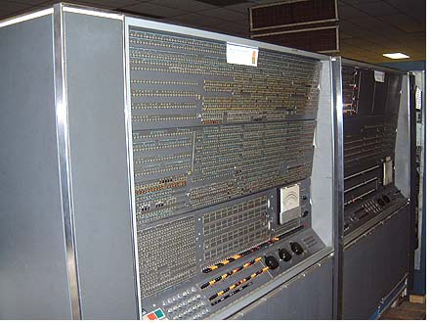
IBM 7030 (1961)

Slide 19
Microelectronics & digital computer
Small electronics and consistent trend towards the reduction in size of electronic circuits.
The basic elements of digital computer must perform storage, movement, processing and control functions.
Two fundamental types of components are required: gates and memory cells. By interconnecting large number of fundamental devices we get a computer.
    Data storage: provided by memory cells
    Data processing: Provided by gates
    Data movement: The path between components are used to move data form memory to memory and from memory through gates to memory
    Control: The path between carry control signal

Slide 20
Generations of Computer
Vacuum tube - 1946-1957
Transistor - 1958-1964
Small scale integration - 1965 on
  Up to 100 devices on a chip
Medium scale integration - to 1971
  100-3,000 devices on a chip
Large scale integration - 1971-1977
  3,000 - 100,000 devices on a chip
Very large scale integration - 1978 to date
  100,000 - 100,000,000 devices on a chip
Ultra large scale integration
  Over 100,000,000 devices on a chip

Slide 21
Moore’s Law
Increased density of components on chip
Gordon Moore - cofounder of Intel
Number of transistors on a chip will double every year. Since 1970’s development has slowed a little
  Number of transistors doubles every 18 months
Consequences of Moore’s law:
Cost of a chip has remained almost unchanged
Higher packing density means shorter electrical paths, giving higher performance
Smaller size gives increased flexibility
Reduced power and cooling requirements
Fewer interconnections increases reliability

Slide 22
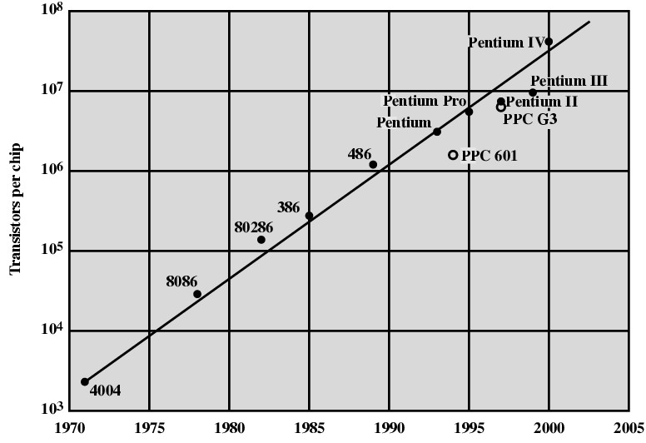
Growth in CPU Transistor Count

Slide 23
Intel
1971 - 4004
  First microprocessor
  All CPU components on a single chip
  4 bit
Followed in 1972 by 8008
  8 bit
  Both designed for specific applications
1974 - 8080
  Intel’s first general purpose microprocessor

Slide 24
Speeding it up
Pipelining
On board cache
On board L1 & L2 cache
Branch prediction
Data flow analysis
Speculative execution

Slide 25
Performance Mismatch
Processor speed increased
Memory capacity increased
Memory speed lags behind processor speed

Slide 26
Pentium Evolution (1)
8080
  first general purpose microprocessor
  8 bit data path
  Used in first personal computer – Altair
8086
  much more powerful
  16 bit
  instruction cache, prefetch few instructions
  8088 (8 bit external bus) used in first IBM PC
80286
  16 Mbyte memory addressable
  up from 1Mb
80386
  32 bit
  Support for multitasking

Slide 27
Pentium Evolution (2)
80486
  sophisticated powerful cache and instruction pipelining
  built in maths co-processor
Pentium
  Superscalar
  Multiple instructions executed in parallel
Pentium Pro
  Increased superscalar organization
  Aggressive register renaming
  branch prediction
  data flow analysis
  speculative execution

Slide 28
Pentium Evolution (3)
Pentium II
  MMX technology
  graphics, video & audio processing
Pentium III
  Additional floating point instructions for 3D graphics
Pentium 4
  Note Arabic rather than Roman numerals
  Further floating point and multimedia enhancements
Itanium
  64 bit
See Intel web pages for detailed information on processors

Slide 29
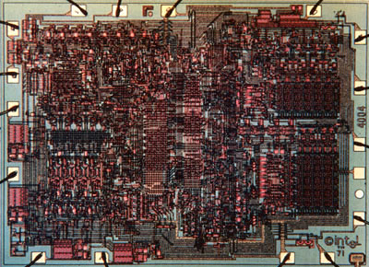
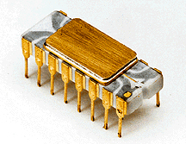
INTEL 4004

Slide 30
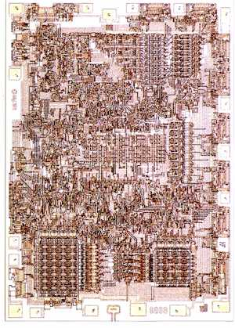

INTEL 8008

Slide 31
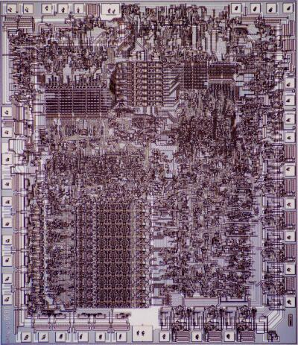
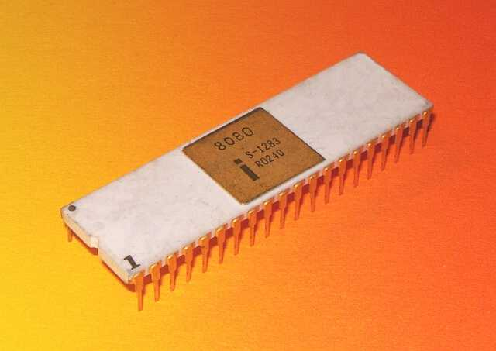
INTEL 8080

Slide 32
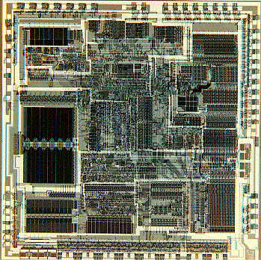

INTEL 80286

Slide 33
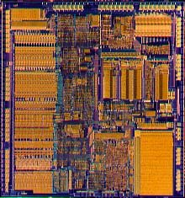
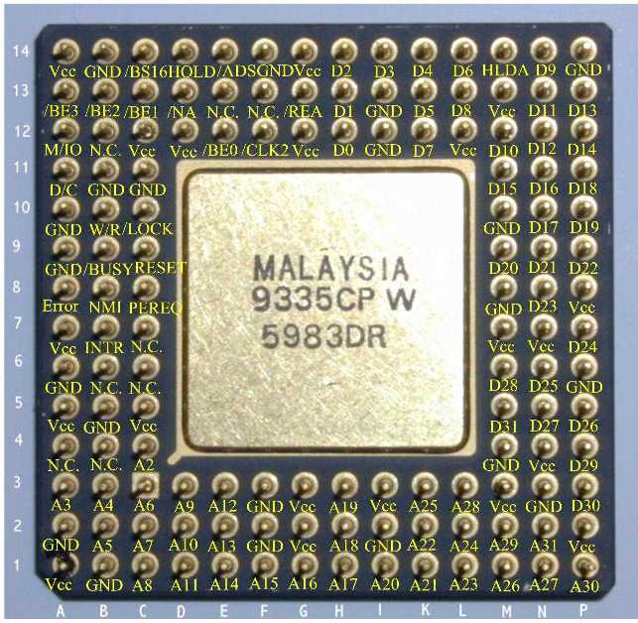
INTEL 80386

Slide 34
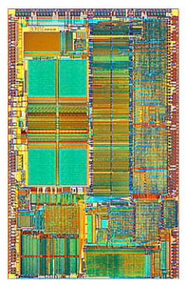
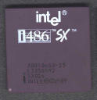
INTEL 80486

Slide 35
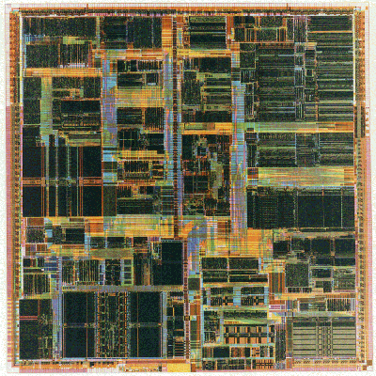
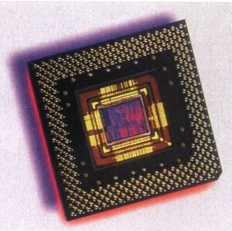
Pentium

Slide 36
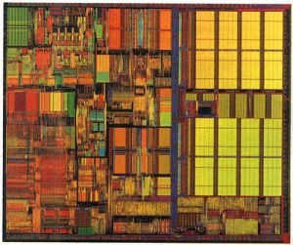
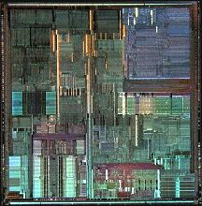
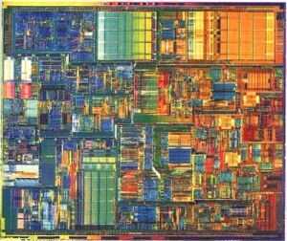
More Pentium
III
Pro
IV

Slide 37
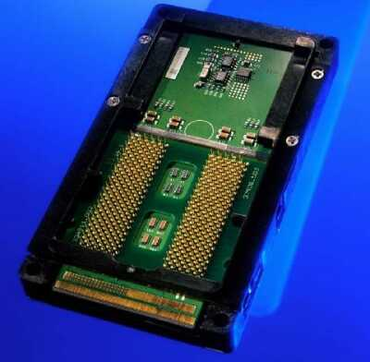
Itanium

